Slide 1



Slide 2

Diabetes Management System Using Food Recognition
Supervised by:
Dr. Muhammad Sardaraz
Group Members:
Seerat Shafique(FA17-BCS-109)
Riffat Nadeem(FA17-BCS-076)
Presented on 06 Dec 2020
Department of Computer Science
COMSATS University Islamabad, Attock Campus

Slide 3
Outline
_______________________________
Introduction
Problem Statement
Objectives
Tools and techniques
Methodology
Functional Requirements
Non-Functional Requirements
Modules
Diagrams
System Snapshots
________________

Slide 4
Introduction
This Application is specially designed for diabetic patient. By this app they can easily maintain their diet.
This app inform patients to take their medicine on time, identify foods that are suitable for diabetics and that do not use dietary monitoring procedures.
_______________________________

Slide 5
Introduction
Our System:
Our application provides platform for everyone that they can easily access all its functionalities.
New things:
This application provides functionality of Calories Recommender.
Old things:
This application also provide functionality of Medicine Reminder, Activity
tracker.
____________________________

Slide 6
Problem Statement
There is evidence that diabetic complications can be prevented, there are still people with diabetes who do not have the necessary knowledge and skills to manage their condition using available health-care technologies and lifestyle changes. Changing lifestyles requires deliberate effort. Therefore, diabetics should take greater responsibility for their care and treatment using available technology-related programs.
_______________________________

Slide 7
Objectives
Helping the diabetic patients and providing them ease in their effective diet plan.
Provide medication reminder that notify patients to take their medication on time.
Keeping track of their daily and weekly activities.
Save time using this app
_______________________________

Slide 8
Tools and Techniques
Tools:
Android Studio
Pycharm
Languages:
Machine learning (python)
Android (java)
MySQL/Firebase
_______________________________

Slide 9
Methodology
API Feature:
We used google API to get location and then adjusted it to perform tasks required
by us.
Classification:
1.Image Acquisition: We acquired the image from android and send it to server
by using rest API in python flask framework
2. Then apply Segmentation will be performed to extract region of interest from image by applying some mask on the image.
3. Then we will apply CNN(Convolutional Neural Network)Algo
classifier in which our dataset get optimal classification.
_______________________________

Slide 10
Functional Requirements
FR-1 Medicine Reminder Module
User can:
Setting time for medicine reminder
Setting the time which notification appear before time of medicine
Incrementing and decrementing the interval
Deleting reminder
Creating notification
FR-2 Activity Module
User can:
Allow permissions to access location
Start tracking
Stop Tracking
Check weekly and daily tracking progress
_______________________________

Slide 11
Functional Requirements
FR-3 Calories Recommender Module
User can:
Allow permissions to access gallery and Photos.
Take picture
Upload Picture
View Details of food
_______________________________

Slide 12
Non- Functional Requirement
NF-1: Efficiency
NF-2: Learnability
NF-3: Maintainability
NF-4: Reliability
NF-5: Usability
NF-6:Availability
NF-7: Performance
NF-8: Understandability
_______________________________

Slide 13
Modules
Our application have three main Modules.
Medicine Reminder
Activity Tracker
Calories Recommender
_______________________________

Slide 14
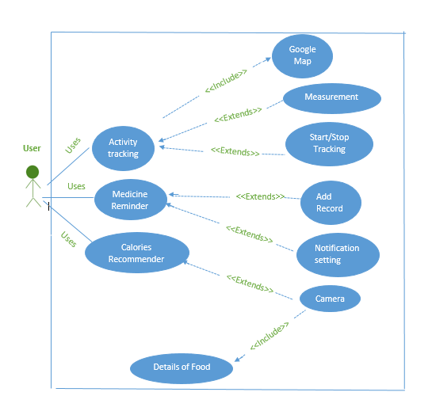
Use Case diagram of our System:
_______________________________

Slide 15
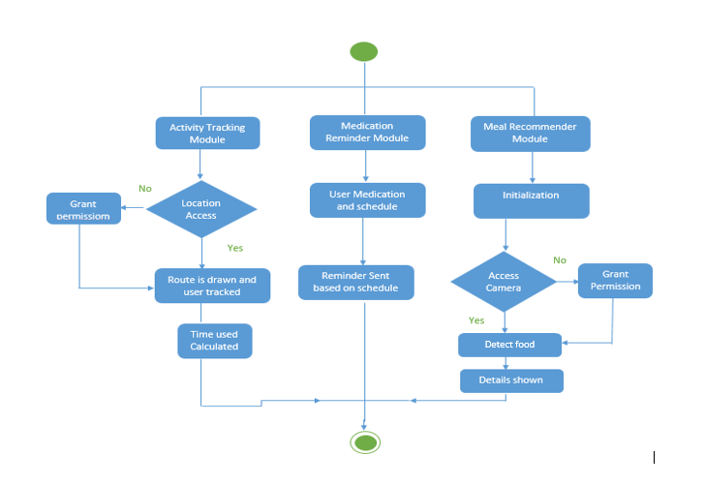
Activity Diagram of our System
_______________________________

Slide 16
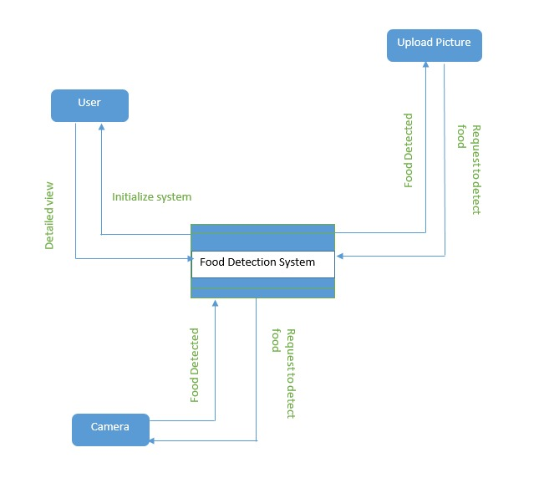
DFD Level-0 diagram
_______________________________

Slide 17
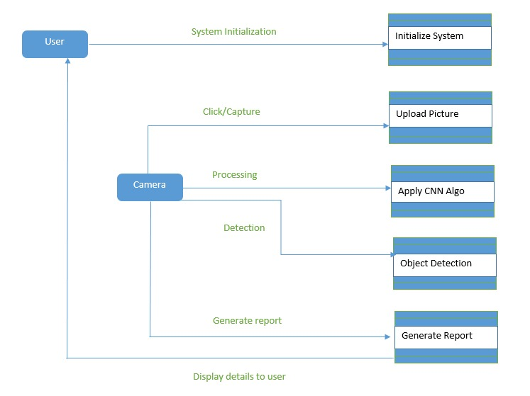
DFD Level-1 diagram
_______________________________

Slide 18
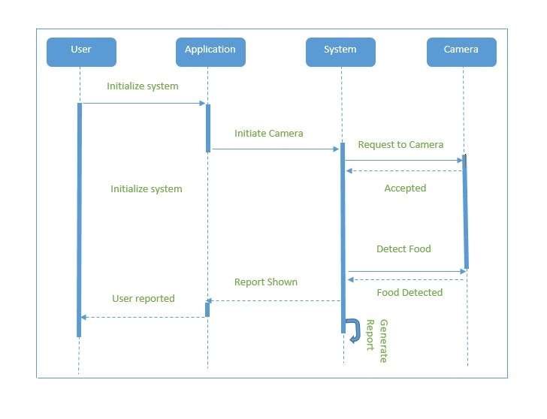
Sequence Diagram of Calories Recommender
_______________________________

Slide 19
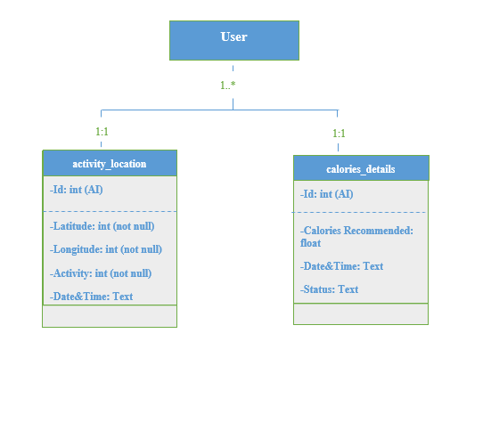
Class Diagram
_______________________________

Slide 20
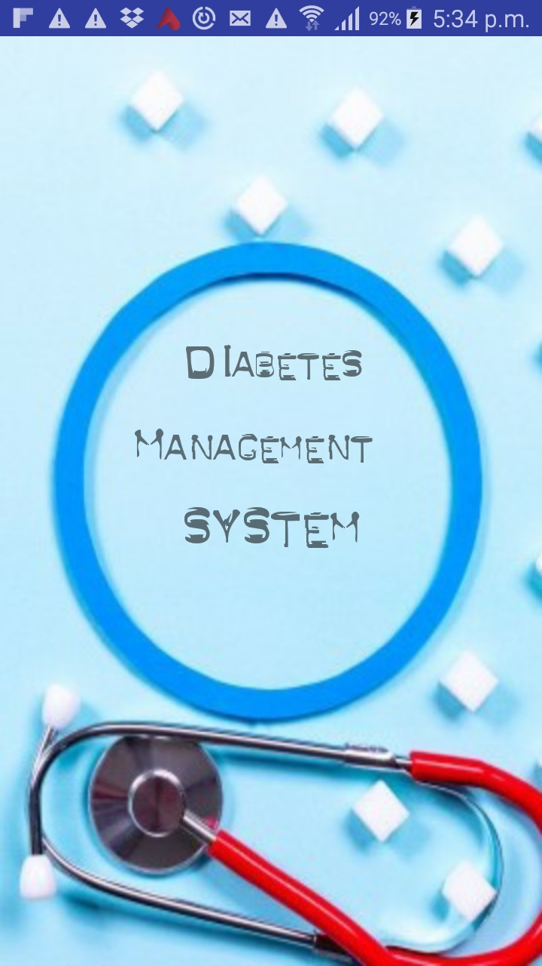
Application Snapshot
_________________________

Slide 21
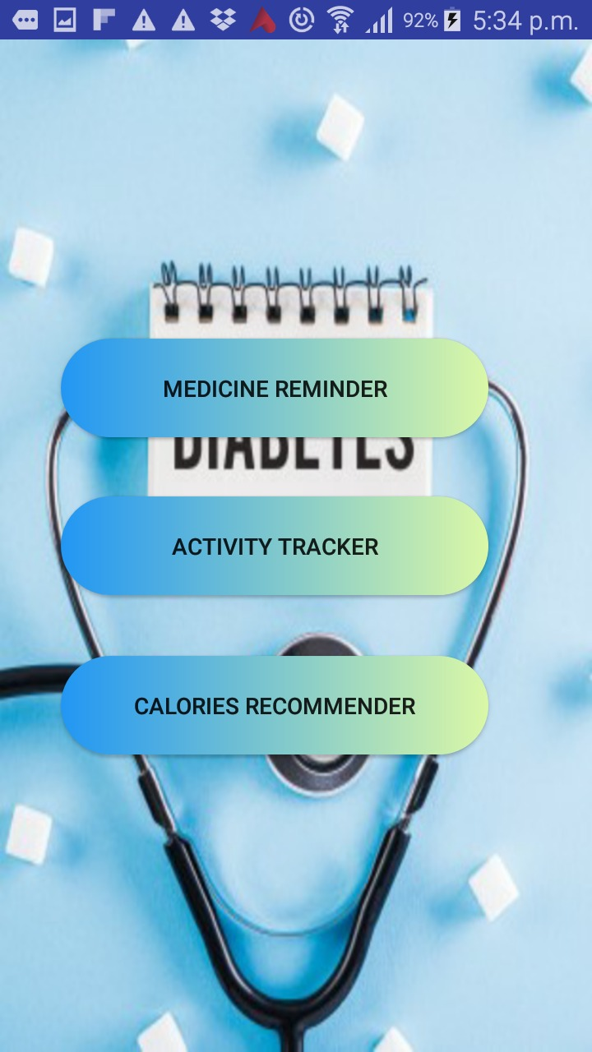
Home Page
_________________________

Slide 22
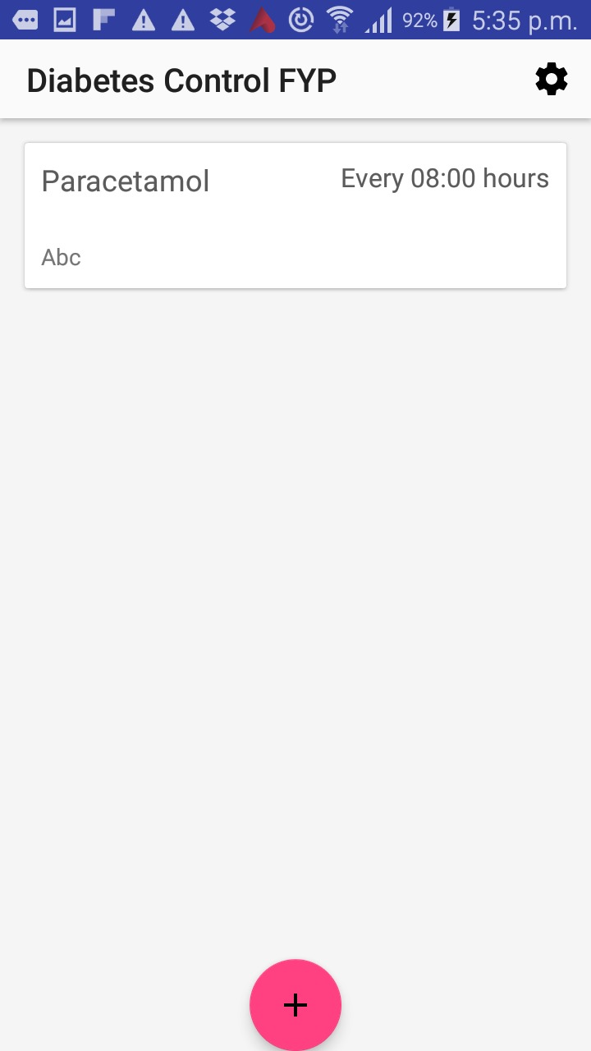
Medicine Reminder-1
_________________________

Slide 23
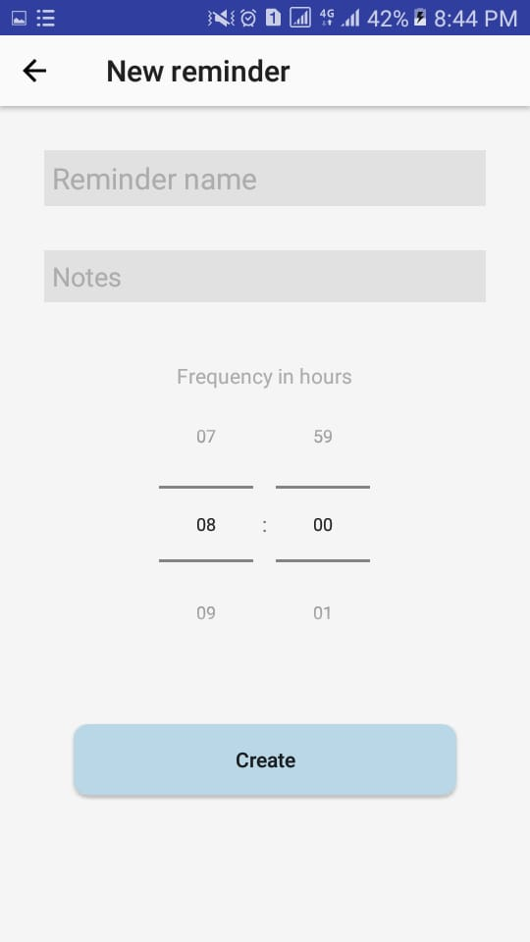
Medicine Reminder-2
_________________________

Slide 24
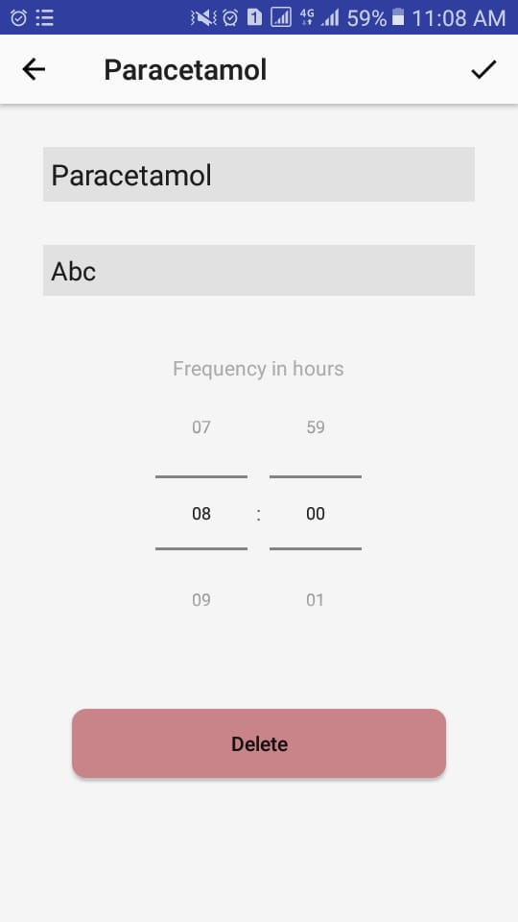
Medicine Reminder-3
_________________________

Slide 25
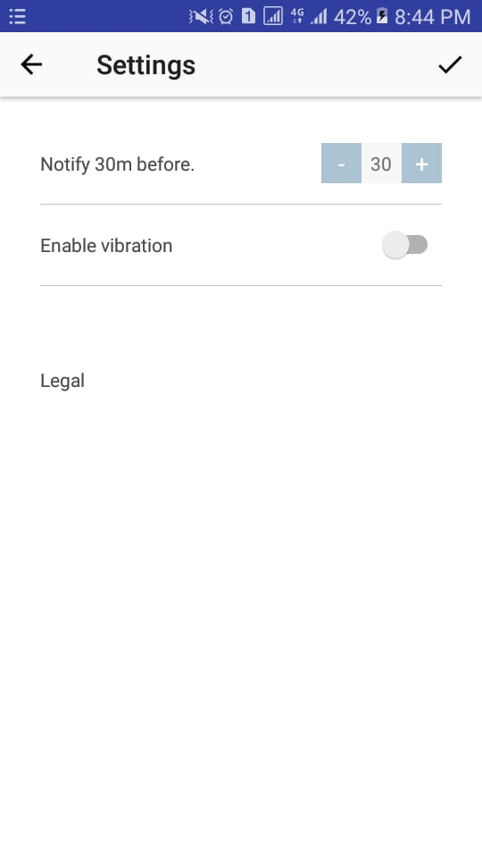
Medicine Reminder-3
_________________________

Slide 26
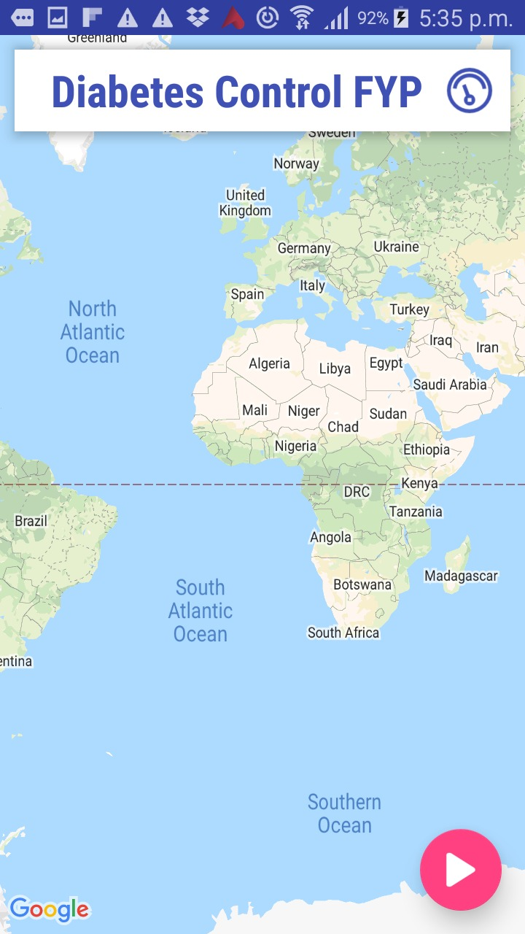
Activity Tracking-1
_________________________

Slide 27
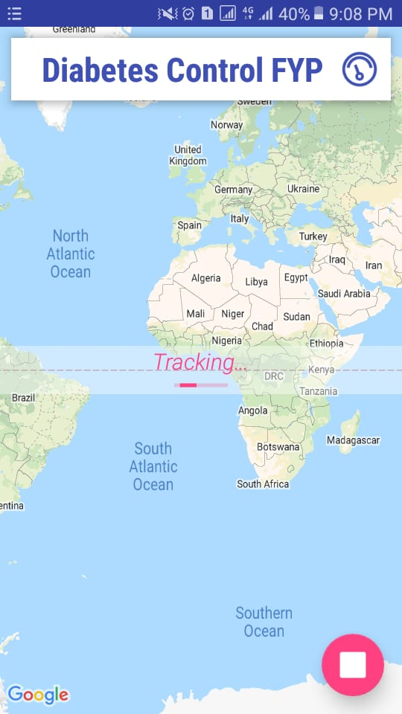
Activity Tracking-2
_______________________________

Slide 28
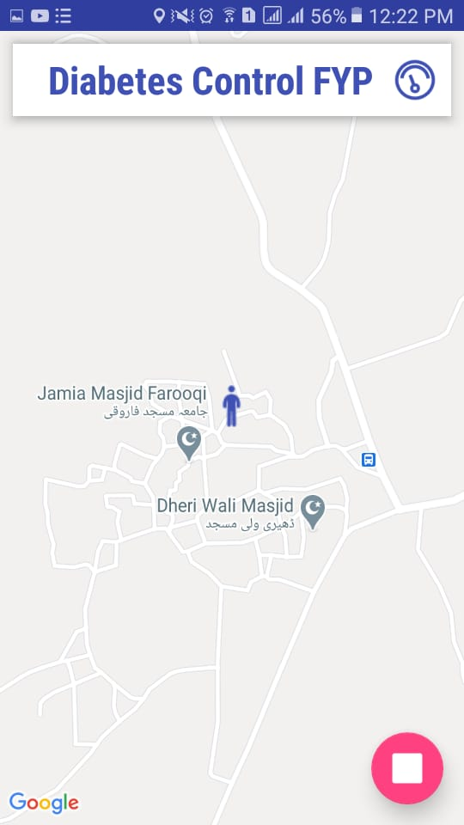
Activity Tracking-3
_______________________________

Slide 29
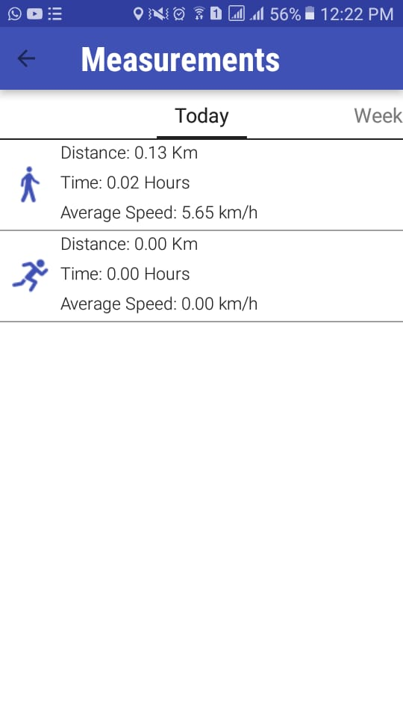
Activity Tracking-4
_______________________________

Slide 30

THANK YOU

